Slide 1
HW2P1 Bootcamp An Introduction to Convolutional Layers FALL 2021
TAs: Dijing Zhang, Diksha Agarwal, Hyungon Yoo

Slide 2
Homework 2 Part 1 Bootcamp
Tensordot Walkthrough
Forward:
Convolution Forward
Backward:
Convolution Backward
Padding and Dilation

Slide 3
Hint
DO NOT:
– Import any other external libraries other than numpy, as extra packages that do not exist in autolab will cause submission failures.
– Add, move, or remove any files or change any file names.
MULTIPLE CHOICE
These questions are intended to give you major hints throughout the homework. Please try to thoroughly understand the questions and answers for each one. Each question has only a single correct answer. (HINT: You can try to code some questions and verify your answers.)
FAQs:
You need to pass forward and backward for “padding and dilation” and “conv1d” parts to get full points.
Don’t use too many for-loops in your program.
You need to copy other needed files from hw1p1. Make sure you get full points in hw1p1!!! (If not, please reach out to TAs)
If you download handout before Oct.04, please redownload it.
Padding and dilation are attributes for convolution operations. You don’t need to implement them in 4.1 and 4.2 but in a separate part, 4.3.

Slide 4
Tensordot Walkthrough (link)
First Segment Example
Input[2, 3, 5]
Sample1[channel=3, size=5]
One batch
Output[2, 2, 3]
Sample2[channel=3, size=5]
One batch
Kernel[2, 3, 3]
Channel1[channel=3, size=3]
Two channels
Channel1[channel=3, size=3]

Slide 5
Tensordot Walkthrough
A = [x, b, c] B = [y, b ,c] → C = np.tensordot(A, B, axes=([1, 2], [1, 2])) = [x, y]
(1, 2) for A or B, instead of taking the 1st and 2nd axes, the 1, 2 axes are removed, so the 0th axis is taken.
It means C[0, 0] = sum(A[0, :, :] * B[0, :, :]), C[0, 1] = sum(A[0, :, :] * B[1, :, :]), …. , C[-1, -1] = sum(A[-1, :, :] * B[-1, :, :])
Loot at the conv1d forward
Input_segment = [2, 3, 3] kernel = [2, 3 ,3] → C = np.tensordot(A, B, axes=([1, 2], [1, 2])) = [bs=2, oc=2]
C[0, 0] means the first sample, the first channel. C[0, 1] means the first sample, the second channel
Conclusion: when we do forward, we hope to keep the out channel axes and batch size axes and remove the in channel and kernel size axes.

Slide 6
Forward
Hint:
One for loop for 1d and two for 2d.
Use tensordot
output size = [(input size - kernel size)//stride] + 1

Slide 7


Backward (link & Recitation 5)
$$\frac{δLoss}{δx}$$
$$\frac{δLoss}{δw}$$
It turns out that the Backpropagation operation is identical to a stride = 1 Convolution of a padded, dilated version of the output gradient tensor with a flipped version of the filter!
It turns out that the backpropagation operation is identical to a stride = 1 convolution operation of the input tensor with a dilated version of the output gradient tensor!

Slide 8
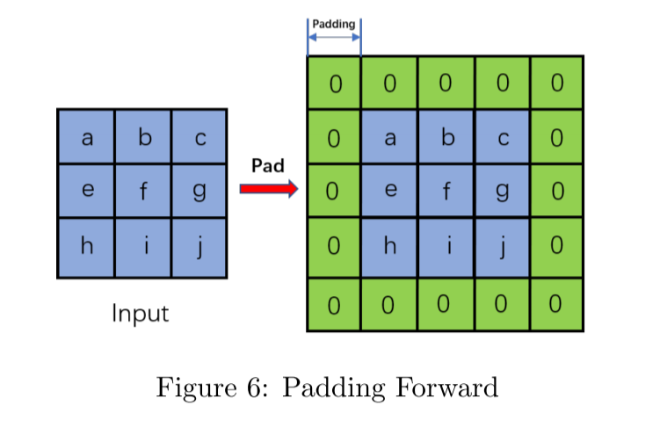
Padding - Forward
Padding controls the amount of padding applied to the input. When we have a deep neural network, we hope to keep enough information and padding will help. Padding will add zeros (right now we only consider constant padding value 0) at the edge of the input. So the padded input size will be:
input size padded = input size + 2 * padding

Slide 9
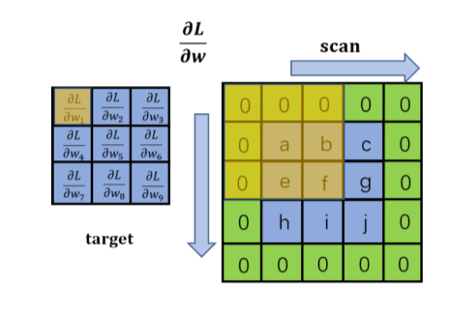
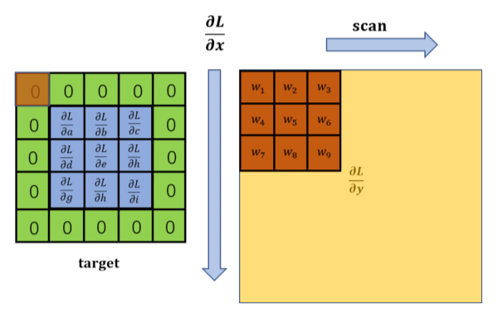
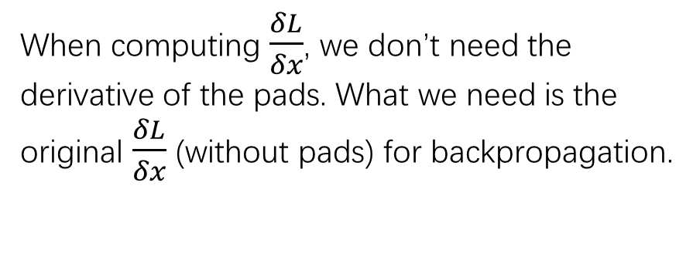
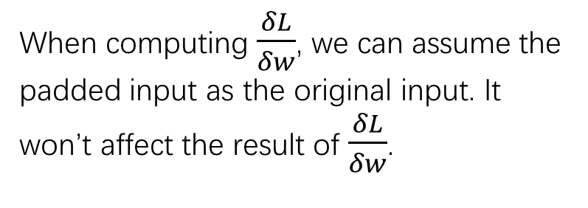
Padding - Backward
Will padding cause a huge difference when we do backpropagation?
When computing $\frac{δL}{δw}$, we can assume the padded input as the original input. It won’t affect the result of $\frac{δL}{δw}$.
When computing $\frac{δL}{δx}$, we don’t need the derivative of the pads. What we need is the original $\frac{δL}{δx}$ (without pads) for backpropagation.

Slide 10
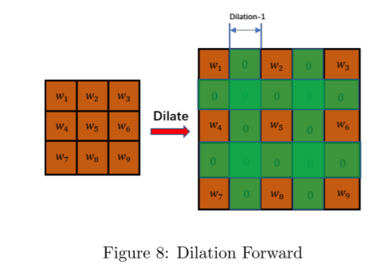
Dilation - Forward
Dilation controls the spacing between the weights in kernels. It aims at increasing the receptive field without increasing the parameters. The default value of dilation is one, and Figure 8 shows the resulting matrix of applying dilation=1.
kernel dilated = (kernel size - 1) * (dilation - 1) + kernel size

Slide 11
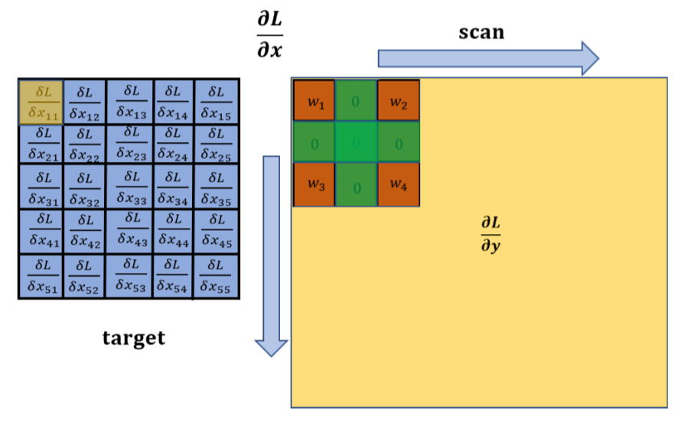
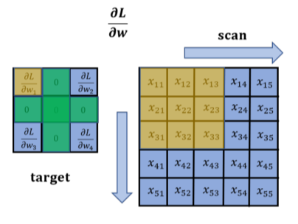
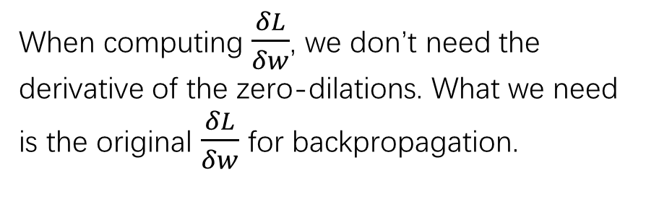
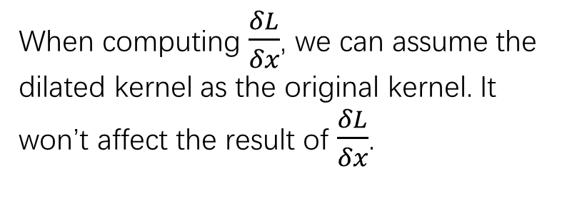
Dilation - Backward
Will dilation cause a huge difference when we do backpropagation?
When computing $\frac{δL}{δx}$, we can assume the dilated kernel as the original kernel. It won’t affect the result of $\frac{δL}{δx}$.
When computing $\frac{δL}{δw}$, we don’t need the derivative of the zero-dilations. What we need is the original $\frac{δL}{δw}$ for backpropagation.

